Slide 1
Five number summary
Descriptive Statistics involves understanding the distribution and nature of the data.
A five-number summary is especially useful in descriptive analyses or during the preliminary investigation of a large data set.
It is used to determine the variability or the differences in data of a dataset and to construct box plots.
Boxplots are used as a visual representation of the data.
It is one of the most efficient ways to detect outliers in our dataset.

Slide 2
Five number summary:
Minimum: the smallest value in a dataset.
Lower Quartile (Q1): the 25th percentile; 25% of the information is less than this value.
Median (Q3): the 50th percentile or middle value. 50% of all data falls below the median.
Upper Quartile (Q3): the 75th percentile; 75% of the information is less than this value.
Maximum: the largest value in a dataset.

Slide 3
An Example of analyzing the data
Our data=(1, 2, 2, 3, 4, 35, 6, 7, 7, 7, 8, 11, 12, 15, 15, 15, 17, 32, 18, 20)
1
Total number of values=20
2
Q1=(25/100)*(20+1)=5.25 => average of 5th and 6th values=(4+6)/2=5
3
Q3=(75/100)*(20+1)=15.75 => average of 15th and 16th values=(15+15)/2=15
4
IQR=Q3-Q1=15-5=10
5
Lof=4-(1.5*10)=-11
6
Uof=15+(1.5*10)=30
7
So, our data=(1, 2, 2, 3, 4, 6, 7, 7, 7, 8, 11, 12, 15, 15, 15, 17, 18, 20)
1. Minimum Value= 1
2. Q1=5
3. Median= 7
4. Q3=15
5.Maximum Value=20

Slide 4
Visualizing the Data using box plots.
To get a quick summary of both centers and spread, combine all five numbers.
The dotted points are the outliers.
Lof
Min
Q1
Q2
Q3
Max
upf

Slide 5
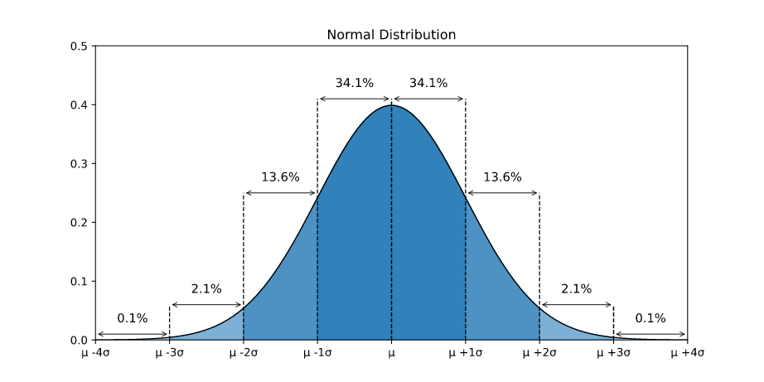
Normal Distribution
The normal distribution is a probability distribution that is symmetric about the mean, showing that data near the mean are more frequent in occurrence than data far from the mean.
The standard normal distribution is a special case of the normal distribution where the mean is zero and the standard deviation is one.This distribution is also known as Z-distribution.
.

Slide 6
Properties of a normal distribution
The mean, mode and median are all equal.
The curve is smooth and symmetric at the center (i.e. around the mean, μ).
Exactly half of the values are to the left of center and exactly half the values are to the right.
The total area under the curve is 1.
In graph form, the normal distribution will appear as a bell curve.
It is smooth and symmetrical about the mean.
The location of a normal distribution is determined by the Mean µ.
The dispersion or spread of the distribution is determined by the standard Deviation.

Slide 7
z-score of Normal Distribution
A z-score (also called a standard score) gives you an idea of how far from the mean a data point is.
It's a measure of how many standard deviations below or above the population mean a raw score is. A z-score can be placed on a normal distribution curve.
If a Z-score is 0, it indicates that the data point's score is identical to the mean score.
The standard score (more commonly referred to as z-score) is a very useful statistic because it
allows us to calculate the probability of a score occurring within our normal distribution
enables us to compare two scores that are from different normal distributions.
The mean is the central tyendency of the normal distribution, defines the location of the peak for the bell curve.
The standard deviation is a measure of variability.

Slide 8
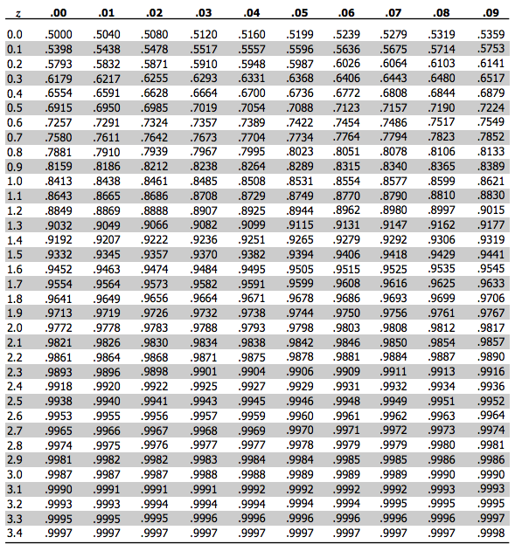
z-score Table
If x is a given score and u and o are the mean and the standard deviation of the entire set of scores, then the corresponding z-score is,
z=(x- µ)/σ
The z-score gives the number of standard deviations that x is from the mean.
The number of standard deviations from the mean is also called the "Standard Score", "sigma" or "z-score".

